Slide 1

Patient counselling for hypertension
BY:
PUNITHA S
4TH YEAR PHARM.D
ANNAMALAI UNIVERSITY

Slide 2
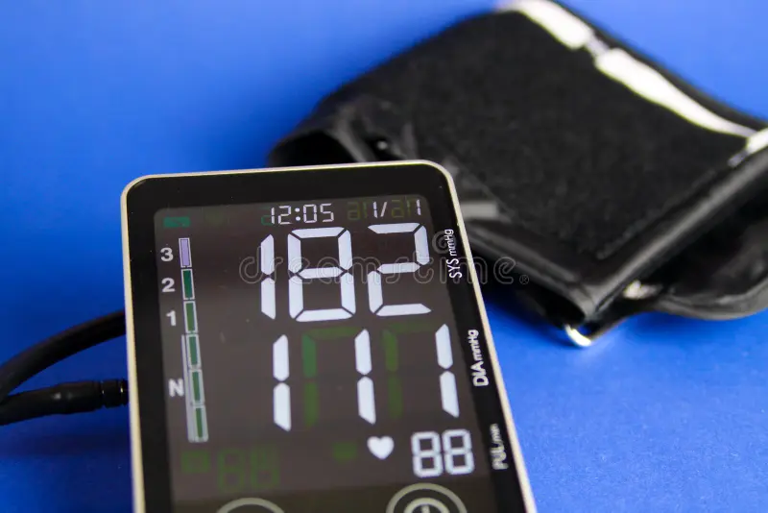
DEFINITION:
Hypertension is a long term medical condition in which the blood pressure in the arteries is persistently elevated.
The systolic blood pressure will be more than or equal to140 mmHg and diastolic blood pressure will be more than or equal to 90 mmHg.

Slide 3
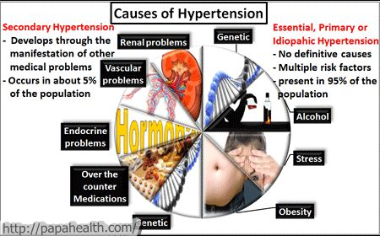
ETIOLOGY:

Slide 4
STAGES OF HYPERTENSION:
Classification of Blood Pressure in Adults
Normal | <120 | AND | <80
Prehypertension | 120-139 | OR | 80-89
Stage 1 HTN | 140-159 | OR | 90-99
Stage 2 HTN | >= 160 | OR | >= 100

Slide 5
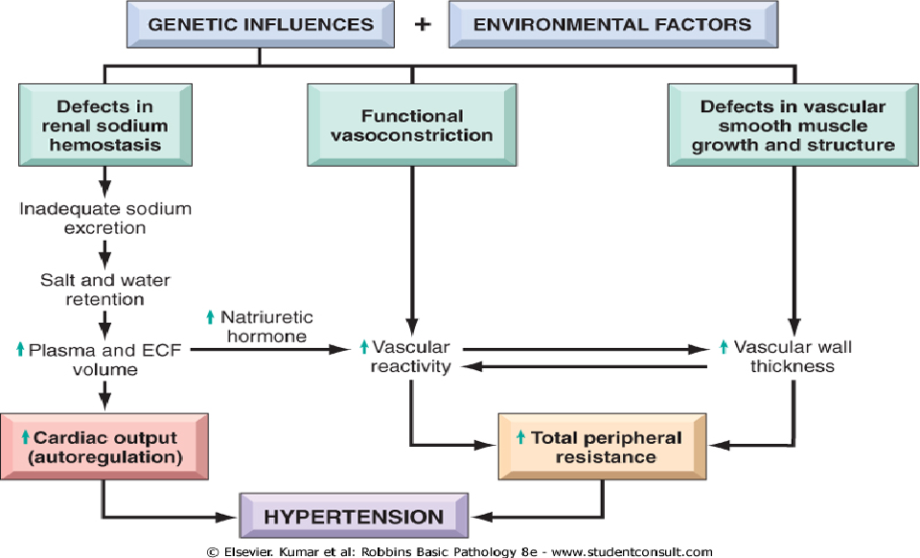
PATHOPHYSIOLOGY:

Slide 6
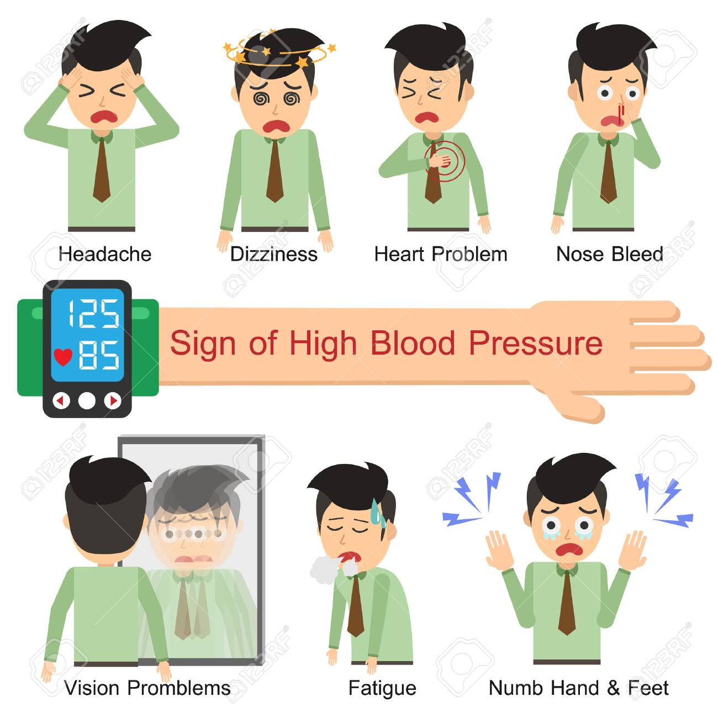
CLINICAL MANIFESTATIONS:

Slide 7
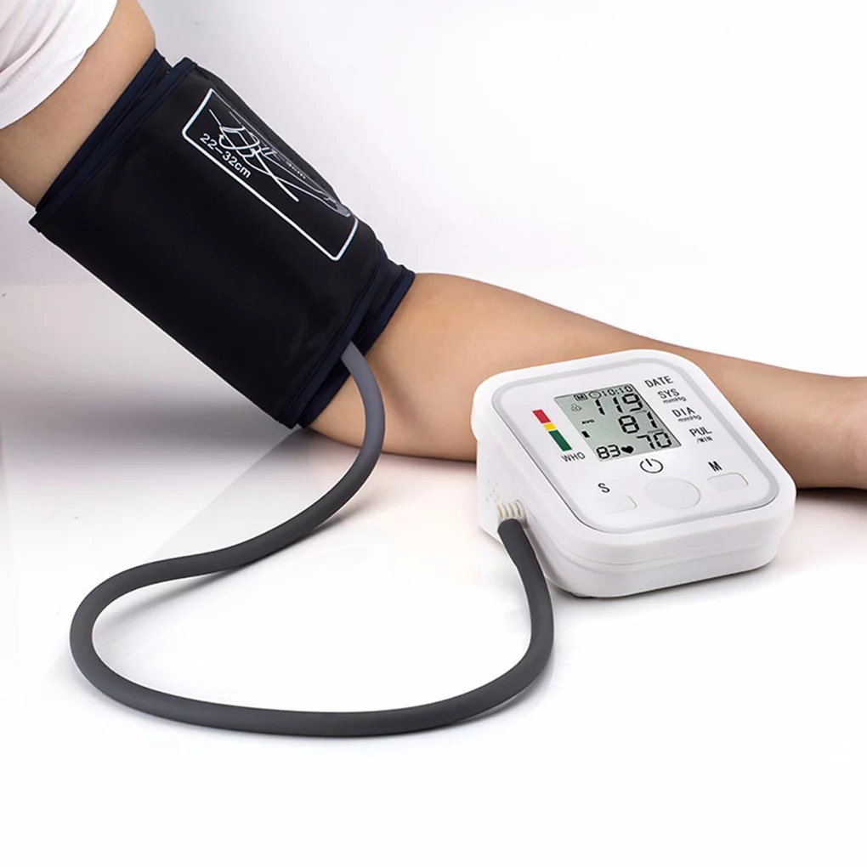
DIAGNOSIS:
Primary hypertension
Only sign is elevated BP
Secondary hypertension
Funduscopic examination
Cardiopulmonary examination
Peripheral vascular examination

Slide 8
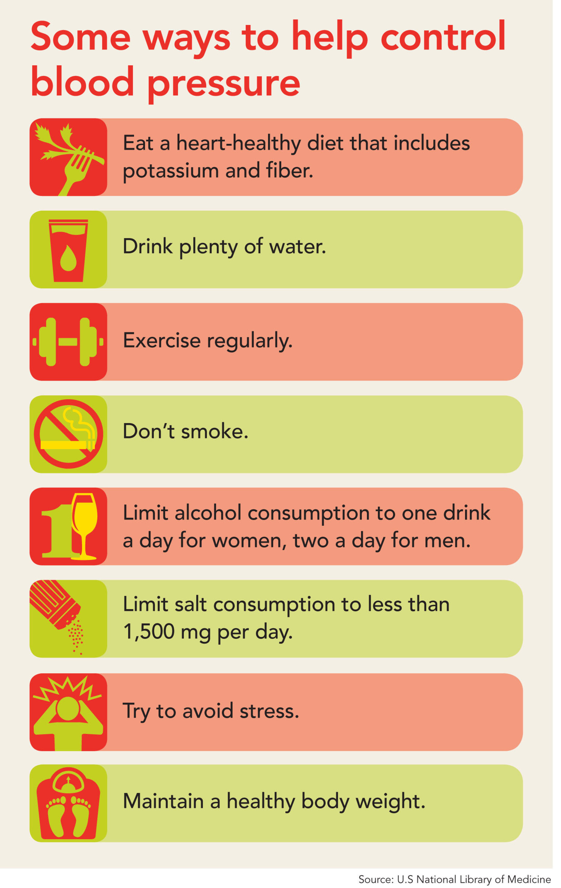
PREVENTION:
Eat a healthy diet.
keep yourself at a healthy weight.
Be physically active.
Do not smoke.
Get enough sleep.
Limit consumption of alcohol.

Slide 9
TREATMENT:
NON PHARMACOLOGICAL TREATMENT
Weight reduction if overweight.
Adoption of the dietary approaches to stop hypertension.
Dietary sodium restriction ideally to 1.5g/day
[3.8 g/day sodium chloride].
Regular aerobic physical activity.
Moderate alcohol consumption .
Cessation of smoking.

Slide 10
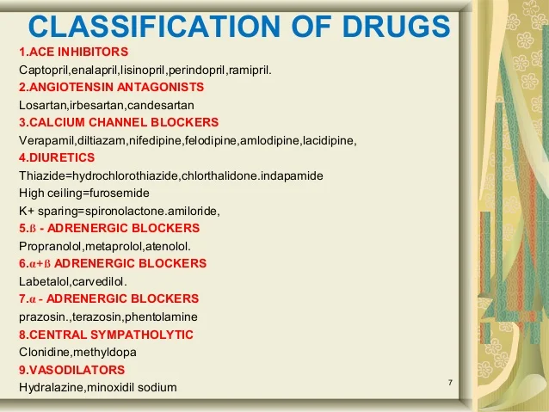
PHARMACOLOGICAL TREATMENT:

Slide 11

PATIENT COUNSELLING:
Lose weight
Reduce alcohol intake
Reduce salt intake
Adopt dash eating plan
Take regular aerobic exercise
Stop smoking
Medication counselling

Slide 12
MEDICATION COUNSELLING:;
Atenolol can be taken twice daily.Your first dose of atenolol may make you feel dizzy,so it is better to take your first dose at bedtime.
Atorvastatin can be taken once daily.It may cause diarrhoea or stomach upset,if any of these happen to you take it with food.
Ranitidine can be taken before food.
Don`t skip any interval of medication during the course of treatment.

Slide 13


